Slide 1
Asset pricing
Presented by Hoang Ngan

Slide 2
Agenda
Histograms – Accounting, Past returns, Tickers
Related works

Slide 3
Histograms – Accounting, Past returns, Tickers

Slide 4
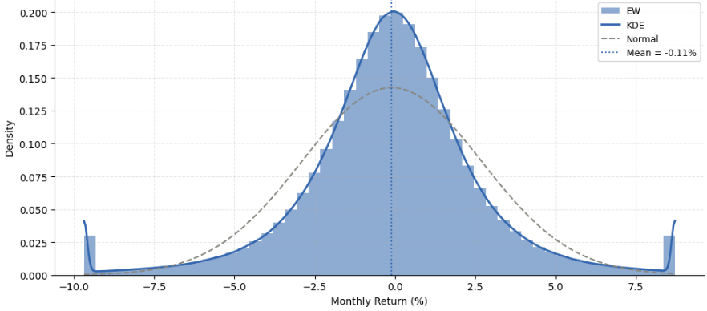
Accounting ratio
Histogram + KDE – EW
Skew = -0.47 | Excess Kurtosis = 157.59

Slide 5
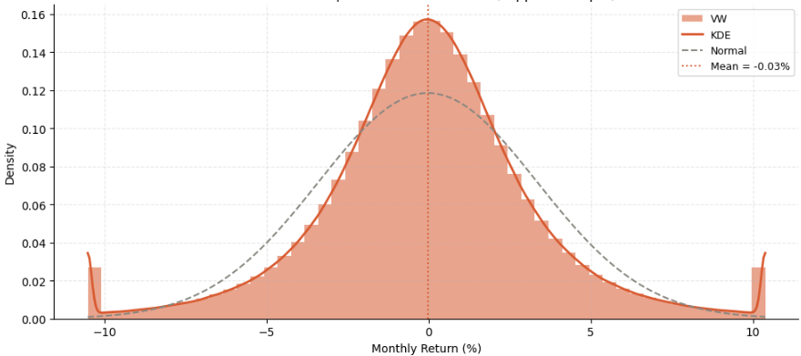
Accounting ratio
Histogram + KDE – VW
Skew = -0.11 | Excess Kurtosis = 96.67

Slide 6
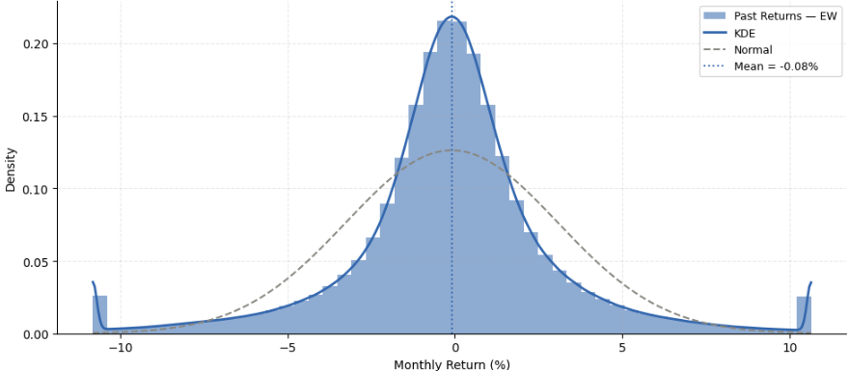
Past returns
Histogram + KDE – Past returns - EW
Skew = 0.36| Excess Kurtosis = 15.82

Slide 7
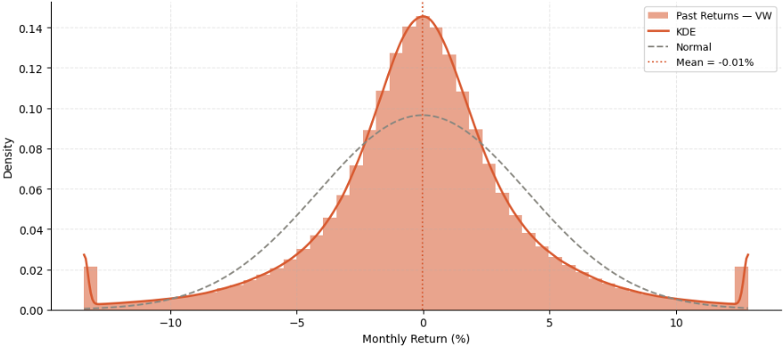
Past returns
Histogram + KDE – Past returns - VW
Skew = 0.12 | Excess Kurtosis = 9.16

Slide 8
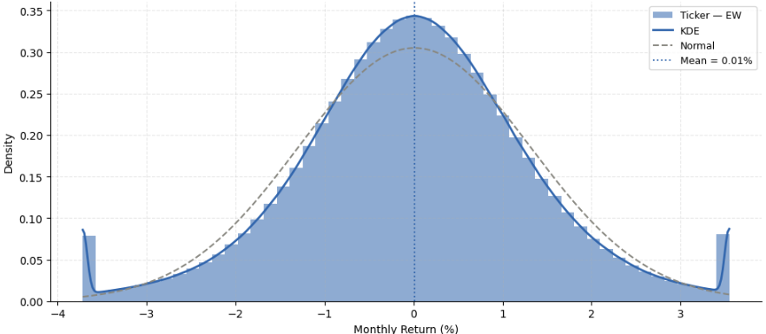
TICKERS
Histogram + KDE – Tickers - EW
Skew = -0.25 | Excess Kurtosis = 3.88

Slide 9
Related works

Slide 10
Alternative Methods
Bayes shrinkage
Bayesian Model Averaging (BMA)
LASSO (Least Absolute Shrinkage and Selection Operator)
False Discovery Rate
Causal Machine Learning
Trees & Neural Networks

Slide 11
Others using open-source dataset
Li, Rossi, Yan & Zheng (2025) — "Machine Learning from a Universe of Signals" — Journal of Financial Economics (need CRSP)
Marrow, Benjamin and Stefan Nagel (2024). Real-Time Discovery and Tracking of Return-Based Anomalies (use part returns)

Slide 12
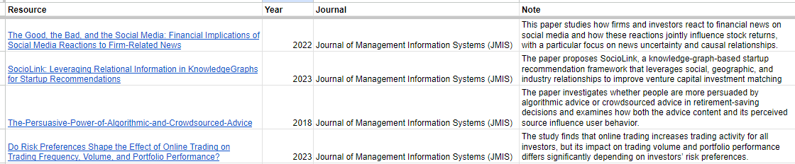
Journal of Management Information Systems (JMIS)

Slide 13
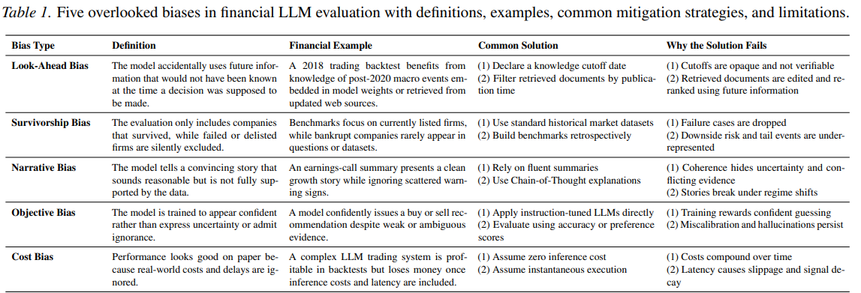
Evaluating LLMs in Finance Requires Explicit Bias Consideration

Slide 14
Xây dựng knowledge graph trên tập asset pricing (dynamic graph, temp graph) – tìm code
Tìm 1 nhóm bài toán asset pricing recommendation, sentiment

Slide 15
CONCLUSION

Slide 16
In fact, in the domain of stock portfolio selection, the return and risk attributes of the investment are considered technical criteria.

Slide 17
Alternative Methods
Statistical Methods
Frequentist testing
Bayesian shrinkage
Sparse / Classical ML
LASSO
Elastic Net
Random Forest
Deep Representation Learning
Deep learning
Graph learning
Embeddings

